Slide 1

TEA’s Hardware Profit Margin Analysis
Arinze Francis Ojinnaka
TEA Pricing Analyst

Slide 2
Project Brief
The TEA Profit Margin dashboard and report provide a detailed view of TEA’s hardware total revenue trend (e-commerce and field sales channels), gross profit, gross profit margin, number of orders, total customers, and order rate by fiscal periods, customer segments, category, region, quarters, product category, weekdays, as well as KPIs such as MoM%.
It visualizes the total revenue for each fiscal period, which customer segment drove the most revenue, and the composition of how the regions fared, including key metrics like basket size compared to last year.
By analyzing these trends, TEA can gain a deep understanding of its transactional sales and profit margin performance and identify areas for improvement.

Slide 3
Table of Contents
Business Problem and Data Source
Data Methods
Tech Stack
Dashboard End users and layout
What I learned from the case
Integrating Interactive PowerBI into the presentation
Insights from the case
Recommendations 1 and 2
Limitations of the case
Future Implications
Appendix
Conclusion

Slide 4
Business Problem and Data Source
Case Problem:
I recently started in TEA, and the Sales organization is asking me for recommendations on driving up the Hardware profit margin and closing the gap to forecast.
Data Source:
I received the data from the Manager in an excel file containing a sample transactional data table (fact table) with three more independent tables (dimension tables) that tell me more about the customer region, segments, and category.

Slide 5
Tech Stack
I used the combination of Microsoft Excel and PowerBI to solve this case, analyze insights, visualize the data and offer recommendations.
Excel: The reasons are:
To perform advanced manipulations of the data to have the lowest level of granularity.
To get a quick summary of the data and understand each distinct feature of the columns.
Microsoft PowerBI: The reasons are:
To define complex calculations using DAX.
To create a calendar table that allows me to perform robust time intelligence calculations.
To bring data to life by having access to dynamic data visualizations.
To empower end users to drill through the charts and uncover insights that would have not been noticed through the numerous filters and icons I provided on the dashboard..
For quick automations of the analysis as the transaction file grows.
To build relational models from the multiple tables in the excel file.
To migrate my live visuals from PowerBI to this report so as to enable the users to interact with it.

Slide 6
Dashboard End Users and Layout
End Users: The end users of the dashboard are the senior executives, which consist of the ecommerce insights and pricing manager and sales managers for TEA. The executives will be using the insights from the dashboard to make data-driven decisions. The sales managers are interested in using this data to maximize growth and improve pricing.
Dashboard Layout: The TEA Profit Margin Dashboard is a combination of both exploratory and explanatory analysis. It identifies interesting patterns and trends that show key business drivers.

Slide 7
What did I learn from the case?
The case was a challenging, exciting, yet interesting one that got me out of my comfort zone.
The data has a lot of hidden insights that could drive up the hardware profit margin at TEA.
It brought out my analytical, problem solving, and dashboard designing skills.

Slide 8
Integrating Interactive PowerBI into the presentation

Slide 9
Insights gotten from the case
Among the six fiscal periods, the November 2020 fiscal period had the highest hardware revenue (e-commerce) of 19.5%, which is equivalent to selling 195 more hardware units in that month, while the July 2020 fiscal period had the lowest hardware revenue (e-commerce) of 10.2%.
There was a sharp drop in hardware revenue (field) by 11.9% for the October 2020 fiscal period. We need to investigate and understand why there was a sharp drop in sales for the month.
The Offentlig customer category is the most profitable category of our customers, accounting for 66.4% of hardware revenue in the e-commerce section and 82.8% of hardware revenue in the field section meaning that 83 out of 125 hardware revenue (e-commerce) came from the Offentlig customer category and vice versa.
The Ost region is the most profitable region, accounting for 45.9% of hardware revenue in the e-commerce section and 55% of hardware revenue in the field section which means 459 out of 1000 hardware revenue (e-commerce) came from the Ost and vice versa.

Slide 10
Recommendations 1
How can we drive up the Hardware profit margin?
Increasing Selling Price: TEA can carefully analyze its pricing plans to ensure that its hardware products are competitively priced while also maximizing profit. To optimize its pricing structure, TEA can consider value-based pricing, which involves charging a premium for their unique offerings; dynamic and tactical pricing, which involves setting flexible prices for its hardware products based on market demand; or product bundling, which includes upselling and cross-selling to encourage its customers to purchase more which leads to an increased average order value (AOV).
Reducing Cost of Production: TEA can identify areas where it can cut unnecessary costs without compromising the quality of its products or services. This can be done by negotiating better terms, discounts, or bulk purchase prices with suppliers or investing more in technology and automation to improve productivity and reduce labor costs.

Slide 11
Recommendations 1
How can we drive up the Hardware profit margin?
Investing in quality and Innovation: TEA can invest more in research and development of its hardware products, innovating and offering unique value to its customers as this will command premium prices and customer loyalty.
Focus heavily on High value customers and regions: TEA can invest in marketing and sales efforts that target high-value and loyal customers tailoring its marketing and sales efforts to their needs and preferences. This can be targeting more of customers in the Key Account Segments, Offtenlig, and in the Ost region.

Slide 12
Recommendations 2
How can we close the gap to forecast?
By segmenting and lowering level of granularity: TEA can close the gap by segmenting its forecast by product lines, customer segments, regions, or sales channels. Different segments may have different behaviors and dynamics, and forecasting accuracy can increase when these subtleties are included.
Involving all stakeholders: Closing the gap to forecast is not an individual effort, the manager needs to involve the sales teams, product manager, pricing manager, and other relevant stakeholders in the forecasting process.
Regular monitoring and Adjustments: There needs to be a constant monitoring and adjustment on the forecasts based on new data and changing market conditions.

Slide 13
Limitations of the Case
As profit margin is a function of total profit divided by revenue, a column for quantity sold, selling price, and cost price of the hardware should have been included to get more insights from the analysis as these factors determine profit margin.
Presence of null values and 0s (zeroes) in the revenue field and e-commerce. Questions needed to be asked by the analyst about why there were these values and how the analyst could address them.
A customer name column should have been included along with the customer ID, but what I had was the customer ID only. The customer's name column identifies the top and bottom-performing customers by different metrics, but I assumed data privacy issues.

Slide 14
Future Implications
The insights provided by the TEA Profit Margin dashboard and report will have a long-term implication for the company’s growth and sales strategy and overall performance.
By analyzing these, TEA can continue to improve its growth and sales efforts and stay ahead of its competitors. The dashboard will help the company make data-driven decisions about pricing, product category offerings, and customer segmentation, leading to increased growth.

Slide 15
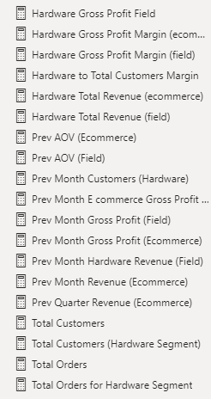
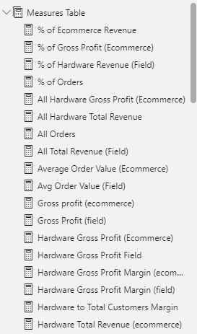
Appendix
The DAX calculations I performed on an independent table I created solely for calculations so as to solve the case.

Slide 16
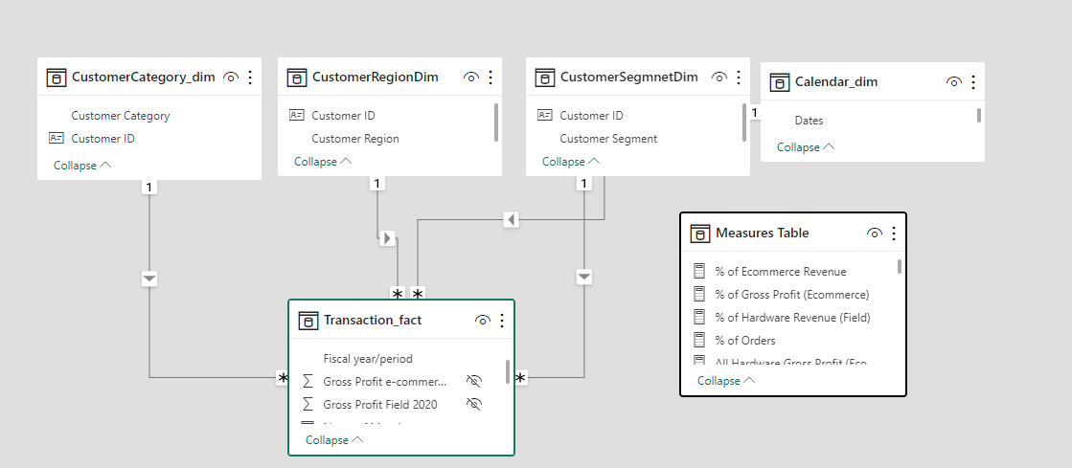
Appendix
The data modeling process of the TEA’s profit margin dashboard for robust analysis

Slide 17
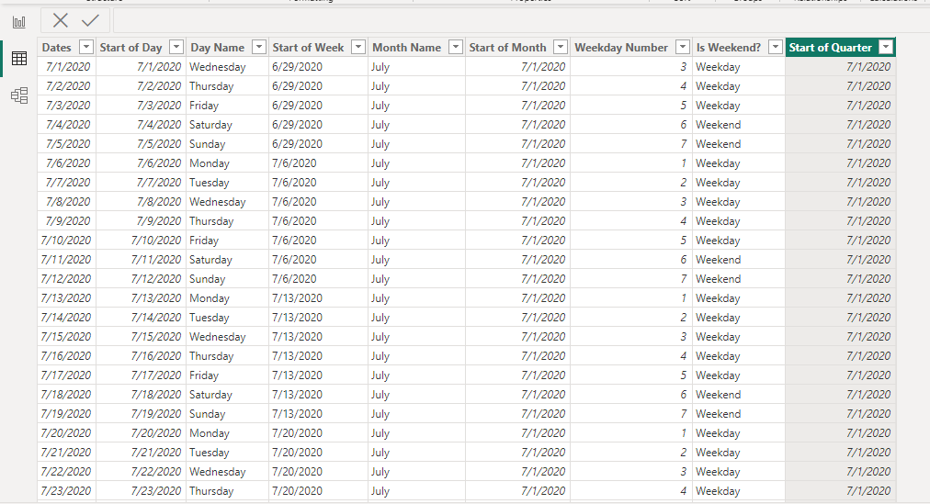
Appendix
The Calendar table I created and included to the model so as to perform robust time intelligence functions.

Slide 18
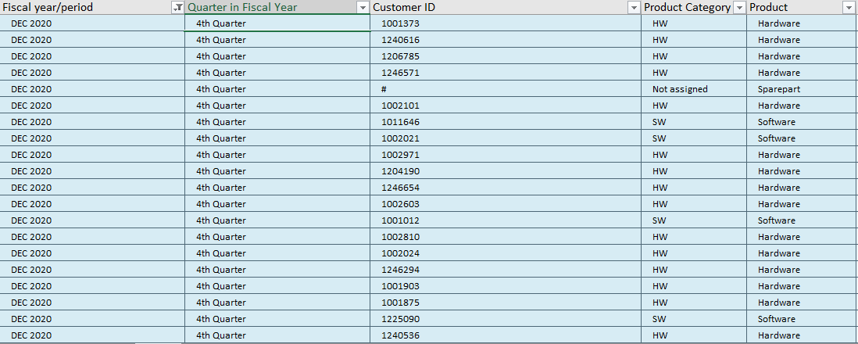
Appendix
I performed advanced manipulations on Excel to derive quarter in fiscal periods in the data so as to have the lowest level of granularity.

Slide 19

Conclusion
Thank you for reading.☺
Arinze Francis Ojinnaka

